Slide 2
Azure IoT Security
2-625
Clemens Vasters
Lead Architect, Azure IoT Services @clemensv

Slide 3
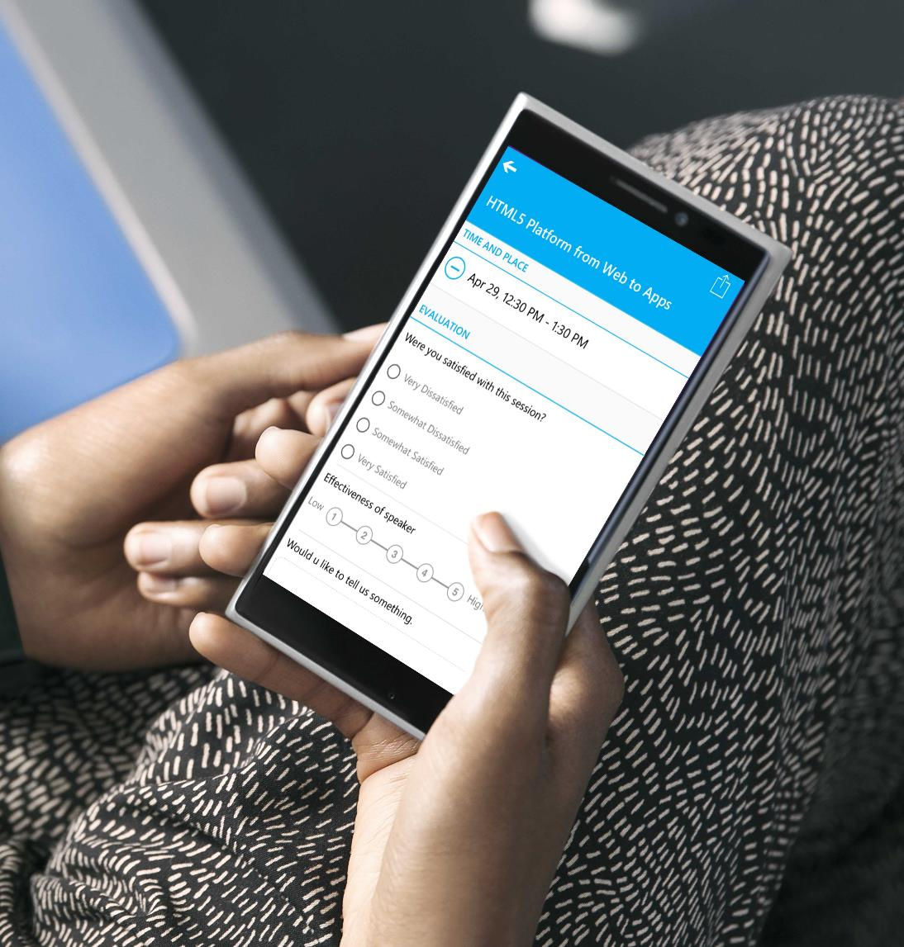

Submit an evaluation for each Breakout Session you attend.
BE ENTERED INTO THE DAILY PRIZE DRAWING!

Slide 4
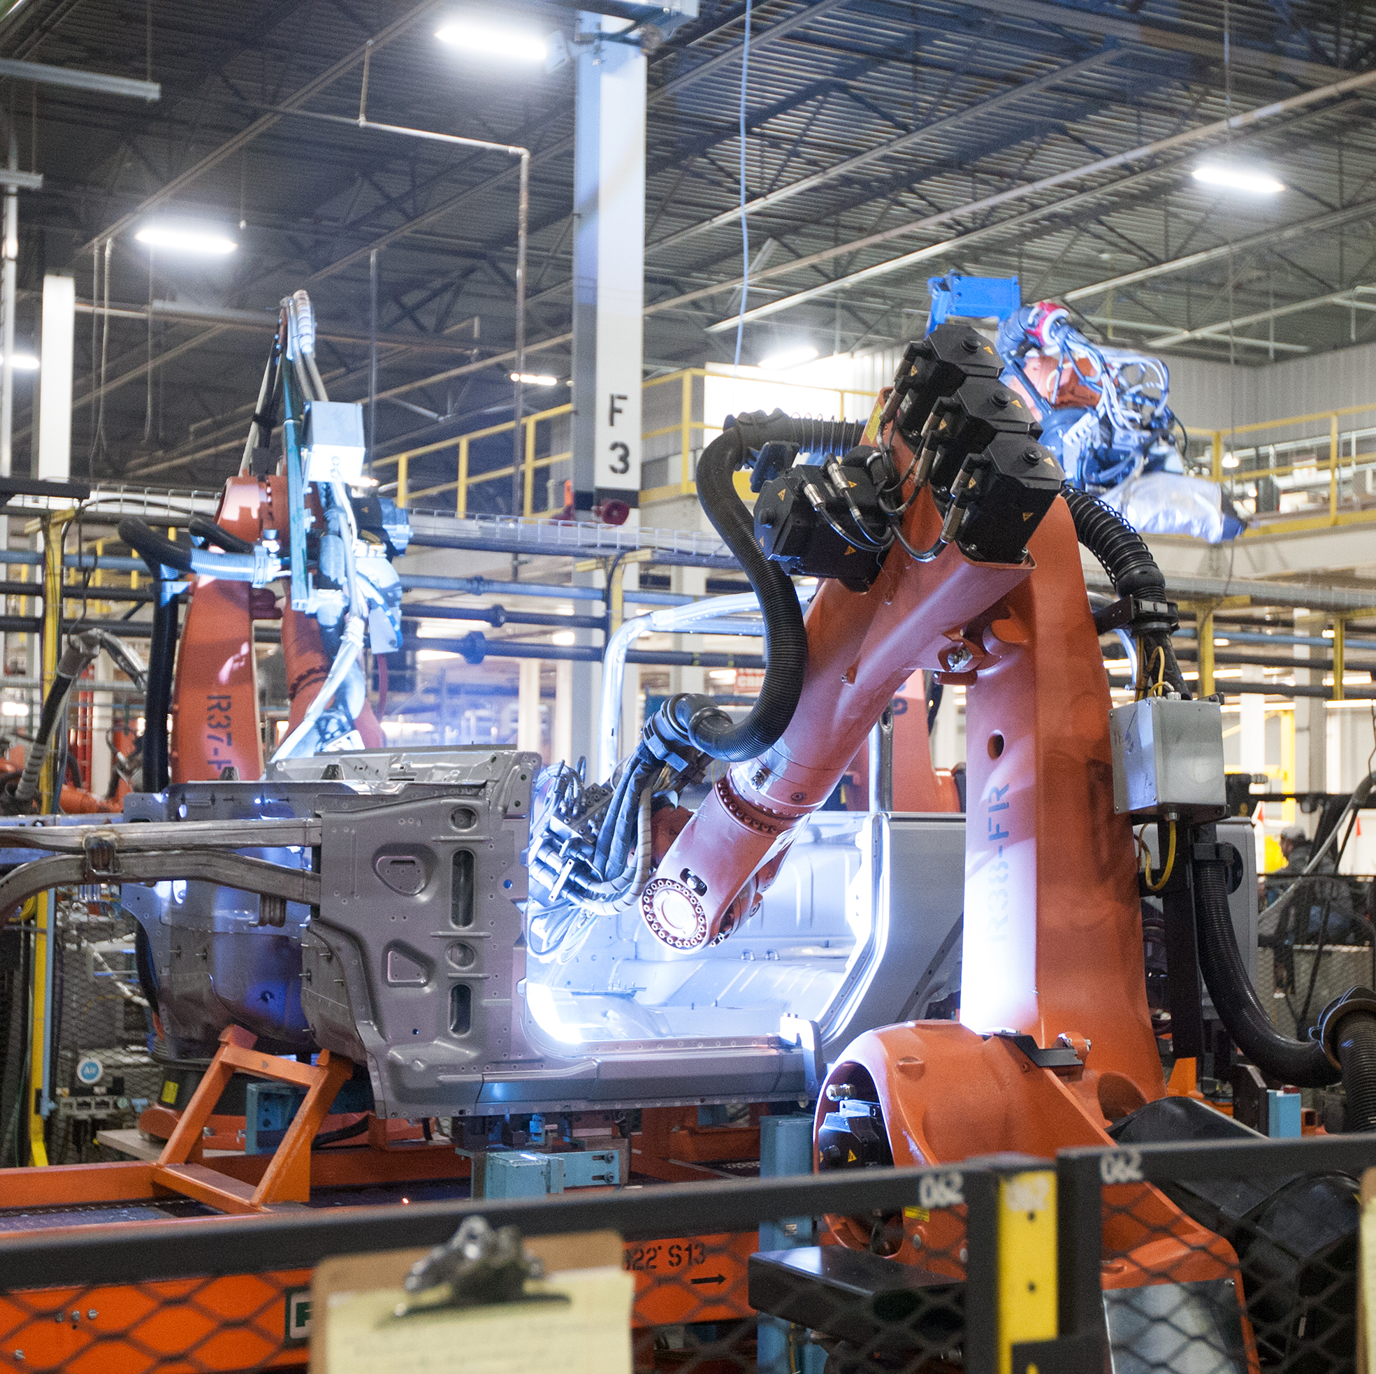
Agenda
Connected Things and the IoT
Inventory – What We Already Know
Security and Privacy Principles
Azure IoT Services
Outlook and Roadmap

Slide 5
Connected Things
Internet
Mobile & Web Interaction
Local Interaction
ISP
Cloud Systems
Cloud Portals and APIs
Personal Environment and Networks
Device
Device
Field Gateway
(Mobile) Network Operators
Cloud Gateway
Analytics
Device
Device
Device
Control System
Local Portals and APIs
Local Gateway
Control System
Analytics
Device
Data Management
MNO Gateway
Data Management
Watches, Glasses, Work Tools, Hearing Aids, Robotic Assistance, …
Homes, Vehicles, Vessels, Factories, Farms, Oil Platforms, …
Vehicle Fleets, Sea Vessels, LV Smart Grids, Cattle, …

Slide 6
IoT Enabled Infrastructure
City
Buildings
Energy
Health
Mobility
Fire Protection
Lighting
Electricity Distribution
Patient Tracking
Traffic Flow
Pollution Control
Water
Wind/Solar/Geothermal
Vital Monitoring
Traffic Alerts
Flood Control
Energy Management
Gas Distribution
Implants
Rule Enforcement
Medical Emergency
Climate Control
Fuel Distribution
Disability Aids
Toll Collection
OR Equipment
Bus/Tram/Train
Drinking Water
Air Quality
Power Plants
Lab Equipment
Taxi
Solid Waste
Lifts and Escalators
Nuclear Waste
Radiology Equipment
Street Quality
Waste Water
Signage
Coal Mining
Mobile Care
Air Traffic Control
Public Order
Safety Management
Oil/Gas Production
Diabetes
Airports

Slide 7
Many IoT solutions control critical operations at the core of industrial and civil infrastructure. Digital security will be increasingly interwoven with physical safety of life and equipment.

Slide 8
Many IoT solutions will provide very deep and near-real time insight into industrial and business processes, as well as into homes and the immediate personal environment. Privacy matters.

Slide 9
Don‘t Panic.

Slide 10
What Do We Already Know?
IT engineers know how to make digital things secure.
Secure Development Lifecycle
Secure Network Technologies
Threat & Vulnerability Mitigation
Monitoring and Alerting
Software/Firmware Auto-Updates
Privacy Models
OT engineers knows how to make physical things safe and secure
Standards, Procedures, Training, Continuous Improvement
Physical access management
Hazard and Risk Analysis
Monitoring and Maintenance
Fail Safe and Safety Equipment
IT and OT engineers need to collaborate in making “cyberphysical” systems safe and secure.

Slide 11



Microsoft Cloud Security Principles
Security Development Lifecycle & Operational Security Assurance
Protect
Network and Identity Isolation
Least Privilege / Just-in-Time (JIT) Access
Vulnerability / Update Management
Auditing and Certification
Detect
Live Site Penetration Testing
Centralized Logging and Monitoring
Fraud and Abuse Detection
Breach Containment
Respond
Coordinated Security Response
Customer Notification

Slide 12
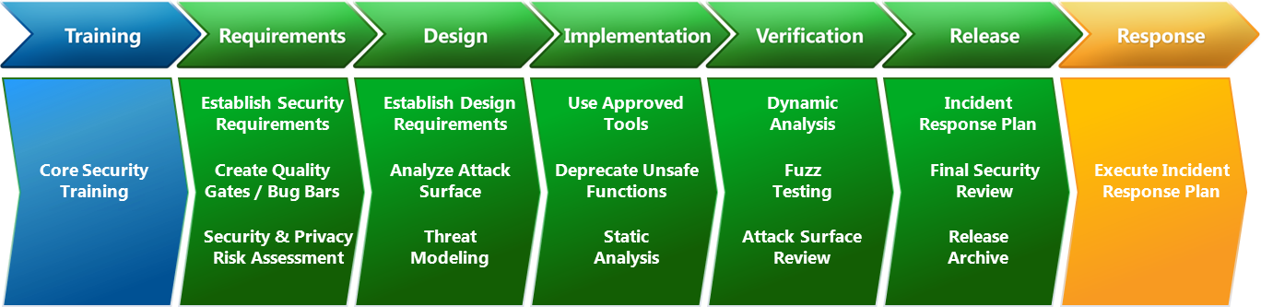
Secure Development Lifecycle
http://microsoft.com/sdl
Development process for creating (and running) secure software as practiced at Microsoft

Slide 13
Defense in Depth
Policies, Procedures, Guidance
Cloud
Field Gateways
Devices
Data Privacy Protection and Controls
Data
Data
Data
Application
Edge
Application
People and Device Identity Federation, Data Attestation
Identity and Access Control
Secure Networks, Transport and Application Protocols, Segmentation
Global Network
Local Network
Local Network
Trustworthy Platform Hardware, Signed Firmware, Secure Boot/Load
Host
Host
Host
Tamper/Intrusion Detection Physical Access Security
Physical
Physical
Physical

Slide 14
Where things get tricky…

Slide 15
Capability constrained devices
IoT Sweet Spot
$400 Phones
$1000 PCs
$1 Sensor
Cost
$10000 Server
Computational Capabilities
Memory/Storage Capacity
Energy Consumption/Source
Component Quality
IoT capabilities are primarily value-add to other primary capabilities
How much computer, storage, and networking circuitry can you add to the BOM for a $40-range retail product for that value-add?
Tiny devices make awfully vulnerable network servers

Slide 16
Not everything is “green-field”
Factories and other industrial and utility environments are “brown-field”
Production lines and facilities represent very significant capital investments
Iterative technology deployment and upgrades
Re-fit of existing (sometimes decades old) equipment with tech add-ons
Buildings and homes are too
Entertainment systems (TV, A/V receivers, Set-Top boxes, Bluray Players)
Comfort and sanitation systems (Heaters, A/C, Water, Gas, Thermostats)
Kitchen appliances
Security systems
IoT solutions must often integrate into environments with devices designed and deployed a decade or more apart

Slide 17
Legacy Network Design Attitude Reality
Network Security modeled after physical access security
Segregated networks. Well-defined gates.
Access control at the network/gateway level.
Network access sufficient to access assets.
Local Interaction
AuthN/Z
Device
Device
Device
Local Portals and APIs
Local Gateway
Control System
Analytics
Device
Data Management

Slide 18

Legacy Remote Access Practices
LAN
LAN
VPN
PLC

Slide 19

Threats?
Spoofing
Tampering
Repudiation
Information Disclosure
Denial of Service
Elevation of Privilege
T,I,D
S,T,R,I,D,E
T,I,D
S,T,R,I,D,E
Service Desk
Machine Control Logic
Operator
T,I,D
S,R
PLC
T,I,D
T,I,D
Configuration
T,I,D
T,R,I,D

Slide 20
What do the boxes help with?
Spoofing
Tampering
Repudiation
Information Disclosure
Denial of Service
Elevation of Privilege
Not a whole lot …
T,I
Service Desk
Machine Control Logic
Operator
Configuration
T,I
… and they even broaden the attack surface area by fusing the networks

Slide 21
What do the boxes really nicely help with?
T,I
Service Desk
Machine Control Logic
Operator
Configuration
T,I
1. Pwn This
2. Pwn That

Slide 22
We’ve also seen this in vehicle telematics
Vehicle
Vehicle
Vehicle
Public APN
Entertainment
CAN BUS / “Telematics Box”
VPN Gateway
ERP
Fleet, Vehicle, and Driver Solutions
CRM
Diagnostics
MNO Private APN
Control
…
…
Vehicle
Vehicle
Own one, own them all
More issues:
+ Addressing and Discovery + Temporal Coupling

Slide 23
Defense Strategies
Will you defend a million tiny, underpowered, public network servers that must triage unsolicited traffic?
Or do you think they could use some help with defense?
Authentication Credentials Management
Authorization Policy Management
Denial of Service
Intrusion Detection
Auditing
Monitoring
Alerting

Slide 24
Service Assisted Communication (SAC)
Access Control Policies
Device Identity Registry/Directory
Connections are device-initiated and outbound
Non-IP
Field Gateway
Q
(CG)NAT Firewall Router
Service Gateway
Client
Q
Device does not actively listen for unsolicited traffic
Public address, full and well defendable server platform
No inbound ports open, attack surface is minimized
Isolated Network
Port Mapping is automatic, outbound

Slide 25
Service Assisted Communication “Peer to Peer”
Device Authentication
Authorization (Access Policy Enforcement)
DoS Defense
Application Layer Integration (vs. Link/Network)
(CG)NAT Router
Mobile Backend
Q
(CG)NAT Firewall Router
Service Gateway
Q
Temporal Decoupling Logical Addressing
Mobile Cell
Mobile Cell

Slide 26
SAC - Trust Brokerage for Nomadic Devices
“Nomadic Devices”
“Resident Devices”
Berlin
2
Local Networking Scope
Token expresses current membership of the device in the solution context.
Asymmetrically signed by directory. Cacheable. Expires periodically.
Tokens
Device Identity Registry/Directory Access Policies
Cloud Scope
Trust

Slide 27
Vehicle Telematics
AMQP 1.0 Link Bi-Directional Secure
Reliable Transfer Application Level
No Peer Exposure
Datacenter(“Cloud”)
Vehicle
Entertainment
CAN BUS / “Telematics Box”
Telematics Gateway
ERP
Fleet, Vehicle, and Driver Solutions
CRM
Diagnostics
Control
…
…
Hard real-time
Control
Near real-time
Value-Add Services, Analysis and Optimization
Servicing

Slide 28
Industrial Automation
AMQP 1.0 Link Bi-Directional Secure
Reliable Transfer Application Level
No Inbound Ports
Cloud Systems
OPC/TCP & Fieldbuses
Cloud Portals and APIs
Device
OPC UA Gateway
AMQP
Cloud Gateway
Analytics
Device
Device
Control System
Local Portals and APIs
Local Gateway
Control System
Analytics
Device
Data Management
Data Management

Slide 29
Updates and the Cyber Supply Chain

Slide 30
Software Component Vulnerability Tracking
Microsoft Study on off-the-shelf devices
Componentization and OSS enables an incredible acceleration of development and feature depth
But the integrator is responsible for tracking vulnerabilities
ROUTER:
102 3rd Party COMPONENTS
WI-FI AP:
35 3rd Party COMPONENTS
BABY MONITOR: 11 3rd Party COMPONENTS
THERMOSTAT
7 3rd Party COMPONENTS
SMART PHONE: 64 3rd Party COMPONENTS
ACTION CAMCORDER: 21 3rd Party COMPONENTS
SMART TV:
12 3rd Party COMPONENTS
MULTIFUNCTION PRINTER: 16 3rd Party COMPONENTS
SMART CAR INFOTAINMENT: 107 3rd Party COMPONENTS
INFUSION PUMP: 3 3rd Party COMPONENTS
SECURITY CAMERA: 21 3rd Party COMPONENTS
SMART SOCKET: 4 3rd Party COMPONENTS

Slide 31
Case Study – Smart TV
Product Family: Smart TV ( 2012 TV lineup ) Product Released: Nov/Dec 2011 Last firmware: Mar 2013 (*
MSRP: $2899
Points of Interest:
“Flat-panel LCD TVs have a lifespan approaching 100,000 hours on average” – this is over 11 years!!!
Smart TVs have one (1) year product cycle. Software from newer models doesn’t often run in older models due to HW differences
Latest available SW is affected by 584 unique CVEs as of March 1, 2015
At which point consumer should determine that product is no longer sage to use?
(* date may not be fully accurate, as e.g. partial OTA updates may have been delivered after this date as well ( see sec. update on Nov 2014)

Slide 32
End of Life product [outlasts it fw]
Nov 2023. End of 100.000 hours average lifespan of LCD TV screen.
Last firmware / SW update:
Mar 2013 (* Approx. 178 unique CVEs affecting product at the moment of SW EoL
Today. March 1, 2015.
584 unique CVEs in 23
components
Estimated
2276 CVEs affecting Product by Nov 2023 based on historic 0.58 CVEs
per day
One year standard warranty for parts and labor from the
date of purchase
2012 Smart TV lineup launched: Nov/Dec 2011
Nov 2014: security update to patch curl, openssl, flash_player,
ffmpeg , libpng and freetype
7 more years of expected
operation of the LCD TV ( based on 100,000 hours average lifespan )
One year product cycle
Approx. 0.58 new CVEs / day over the course of 23 months
11/1/2023
8 years
(* date may not be fully accurate, as e.g. partial OTA updates may have been delivered after this date as well ( see sec. update on Nov 2014)

Slide 33
Study Conclusions
The majority of IoT manufactures seem to be good at releasing updates to their software and even having auto-update features – for a while
3rd Party components developers are typically good about both notifying the public about bugs in their code and providing prompt updates.
Manufacturers don't appear to exercise scrutiny on their cyber supply chain - e.g. incorporation 3rd party code updates are lacking.

Slide 34
Service Cycle includes Software!
Many of the IoT companies have never had to deal with software in their products. This is new territory.
Historically they designed a model, shipped it and then moved on and only ever revisited it if there was a safety recall.
Historically when designing a refrigerator one doesn’t typically think about the risk it poses to washer and dryers on the same network
For many of the new IoT companies the only end-of-life they dealt with was when the product stopped working
Historically manufactures supported a model until the warranty expired after which local repair companies dealt with it.
Can your local repairman patch and update software?

Slide 35
You will not have a choice; start early
Implement a secure development lifecycle for devices that takes the factual lifetime into account.
As networked software becomes safety-relevant and safety-critical, we should expect industry safety standards to broadly require auto-update support for patching critical vulnerabilities.
We should also expect quality assurance companies to only issue certifications for products that include auto-update capabilities and software component tracking procedures.

Slide 36
Scale

Slide 37
The Scale Challenge
x Millions
Event Storage Real Time Analytics
Time Series and State Storage
Historic and Predictive Analytics
Device Software Management
Connectivity
Data Flow
Device Identity Management
x GByte/sec
x PByte

Slide 38
Device Identities. Device Management. Hyper Scale.
Makers. Prototypes. Hackathons.
“Enterprise Scale”
Consumer Products
100
10,000
1,000,000

Slide 39
Azure IoT Hub

Slide 40
Azure IoT Hub
IoT Hub
Field
Cloud
IoT Hub Gateway HTTPS, AMQPS
Data and Command Flow
HTTPS AMQPS
APIs
M
M
Event Hub
M
Self-Hosted Gateway MQTT, Custom
Field Gateway OPC UA, CoAP, AllJoyn, …
Per-device command queues
Identity Registry
OSS Device Agents
Provisioning
Communication
Device Management
Provisioning
Management
Up to 10M Devices per Hub

Slide 41
Azure IoT Hub
IoT Hub
IoT Hub Gateway HTTPS, AMQPS
Data and Command Flow
HTTPS AMQPS
APIs
M
M
Event Hub
M
Self-Hosted Gateway MQTT, Custom
Field Gateway OPC UA, CoAP, AllJoyn, …
Per-device command queues
Hyper-Scale Identity Registry for millions of devices per IoT Hub
Can federate identity with and via Azure Active Directory
Identity Registry
OSS Device Agents
Provisioning
Communication
Device Management
Provisioning
Management

Slide 42
Azure IoT Hub
Secure by Principle.
IoT Hub does not permit insecure connections. TLS is always enforced.
TLS/X509 initially; TLS/PSK & TLS/RPK on roadmap for compute-constrained devices and bandwidth limited or expensive metered links.
IoT Hub
IoT Hub Gateway HTTPS, AMQPS
Data and Command Flow
HTTPS AMQPS
APIs
M
M
Event Hub
M
Self-Hosted Gateway MQTT, Custom
Field Gateway OPC UA, CoAP, AllJoyn, …
Per-device command queues
Native support for Service Assisted Communication model, potentially holding millions of concurrent bi-directional connections.
AMQP 1.0 (with WebSockets), HTTP/2
Identity Registry
OSS Device Agents
Provisioning
Communication
Device Management
Provisioning
Management

Slide 43
Azure IoT Hub
IoT Hub
IoT Hub Gateway HTTPS, AMQPS
Data and Command Flow
HTTPS AMQPS
APIs
M
M
Event Hub
M
Self-Hosted Gateway MQTT, Custom
Field Gateway OPC UA, CoAP, AllJoyn, …
Per-device command queues
All messages are tagged with originator on service side allowing detection of in-payload origin spoofing attempts
Channel-level authentication and authorization against the gateway
Identity Registry
OSS Device Agents
Provisioning
Communication
Device Management
Provisioning
Validation of signatures against identity registry and blacklists (for signature tokens)
Management

Slide 44
Azure IoT Hub
Device management foundation capabilities for device state inventory and update delivery
Device management foundation capabilities for device state inventory and update delivery
IoT Hub
IoT Hub Gateway HTTPS, AMQPS
Data and Command Flow
HTTPS AMQPS
APIs
M
M
Event Hub
M
Self-Hosted Gateway MQTT, Custom
Field Gateway OPC UA, CoAP, AllJoyn, …
Per-device command queues
Identity Registry
OSS Device Agents
Provisioning
Communication
Device Management
Provisioning
Management

Slide 45
Roadmap

Slide 46
IoT Challenges
Policies, Procedures, Guidance
Cost pressure on device hardware
Cheap sensors
Weak/no crypto
Source of randomness
Analog Gap
Manipulations difficult to detect
Insecure Platforms
Tiny Real-Time Operating Systems
Legacy Protocols
Cloud
Field Gateways
Devices
Data
Data
Data
Application
Edge
Application
Identity and Access Control
Global Network
Local Network
Local Network
Host
Host
Host
Physical
Physical
Physical

Slide 47
What can we do architecturally?
Service Assisted Communication
Reduce the attack surface area for system and devices
Only accept commands to the device from a “trusted source”
Enforce secure channel
Machine Identity and Access Authorization
Who is part of a system and gets to submit data?
Authorize the sender
Data Streams and Processing Authorization
Which data gets sent and who is authorized to process which data?
Authorize the receiver
Data Plausibility and Flow Authorization
What is the data quality and how plausible is it considering the system context? Is it plausible enough to permit it flowing further into the system and for it to influence decisions?
Authorize the data stream
Data Attestation, Lineage, and Privacy Control
Where did data originate, who participated in producing it, and how can we answer these questions only in an authorized context and break the associations altogether when required by policy or law?
Authorize identification and association
STRIDE
STRIDE
STRIDE
STRIDE
STRIDE

Slide 48
Call to Action!
IoT Security is a shared responsibility
Security concepts to the edge
Device code, provisioning, certificates, data management
Implement a Secure Development Lifecycle
http://microsoft.com/sdl
Keep track of the cyber supply chain
Work out an incident response plan that includes updates
Leverage industry best practices for defense-in-depth
Select device platforms by best balance between feature and security capabilities for your scenario and budget.
Leverage best practice network design, but don’t just trust the network.
Establish security boundaries at the application layer

Slide 49
Call to Action!
Build on the Azure IoT Suite and IoT Hub
Secure, Service Assisted, Bi-Directional Communication
Hyper-Scale Device Identity Management
Device Management Foundation
Review our platform principles and certifications
Azure Trust Center http://azure.microsoft.com/en-us/support/trust-center/
ISO 27001/27002
SOC 1/SSAE 16/ISAE 3402 and SOC 2
Cloud Security Alliance CCM
FedRAMP
FISMA
FBI CJIS (Azure Government)
PCI DSS Level 1
United Kingdom G-Cloud
Australian Government IRAP
Singapore MTCS Standard
HIPAA
CDSA
EU Model Clauses
Food and Drug Administration 21 CFR Part 11
FERPA
FIPS 140-2
CCCPPF
MLPS

Slide 50
Resources
Improve your skills by enrolling in our free cloud development courses at the Microsoft Virtual Academy.
Try Microsoft Azure for free and deploy your first cloud solution in under 5 minutes!
Easily build web and mobile apps for any platform with AzureAppService for free.

